Slide 1
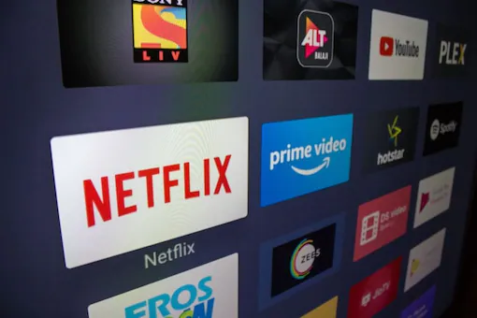
OTT PLATFORM ANALYSYS TOOLS
TEAM MEMBERS:
Sujana Sri Chidara
Juveria Shaista
MD Gulam Mustafa

Slide 2
OUTLINE
INTRODUCTION
OBJECTIVE
IBM CLOUD
IBM COGNOS ANALYTICS
DATA SETS
DATA VISUALISATION
DATA VISUALISATION CHARTS
DASHBOARD CREATION
CONCLUSION

Slide 3
INTRODUCTION
In recent years, the advent of various OTT platforms has introduced a novel issue: the difficulty in choosing which OTT platform to subscribe to. Netflix, amazon prime, and disney+ are some of the many OTT services that are well-known to the public, but the number of services is growing as localized OTT platforms like watcha (south korea ) and voot ( india) are joining the line. As these platforms are coming up with new ways to stand out among competitors by presenting original content, it is evident that more customers are being lost in deciding which platform would be suitable for their use. Moreover, most of the available recommendation systems are focused on suggesting the content but not the platforms that hold and provide those contents. To ease the choice dilemma, our study aims to present a guideline for choosing the appropriate OTT platform that fits one’s personal preferences. Therefore, it is the right time to analyze different OTT platforms and provide useful information for people who are not able to decide which platform fits them best.

Slide 4
OBJECTIVE
So the main objective of this challenge is to investigate different OTT platform data sets and analyze the utilization of OTT platforms across the country
Especially during the last 2 years, and provide insights on regions, shows, reviews, languages, genres, etc.
BY THE END OF THIS PROJECT YOU WILL KNOW:
Know fundamental concepts and can work on IBM Cognos Analytics.
Gain a broad understanding of plotting different graphs.
Able to create dashboard.

Slide 5
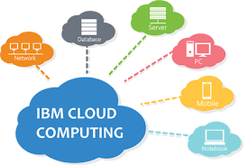
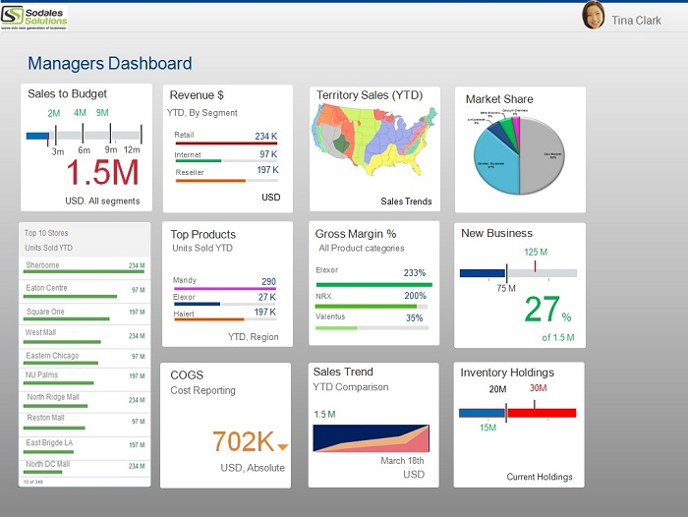
IBM CLOUD
IBM cloud is a suite of cloud computing services from IBM that offers both platform as a service (paas) and infrastructure as a service (iaas). With IBM cloud iaas, organizations can deploy and access virtualized IT resources -- such as compute power, storage and networking -- over the internet.
IBM COGOS ANALYTICS
IBM cognos analytics is a set of business intelligence tools available on cloud or on-premise. The primary focus is in the area of descriptive analytics, to help users see the information in your data through dashboards, professional reporting and self-service data exploration.

Slide 6
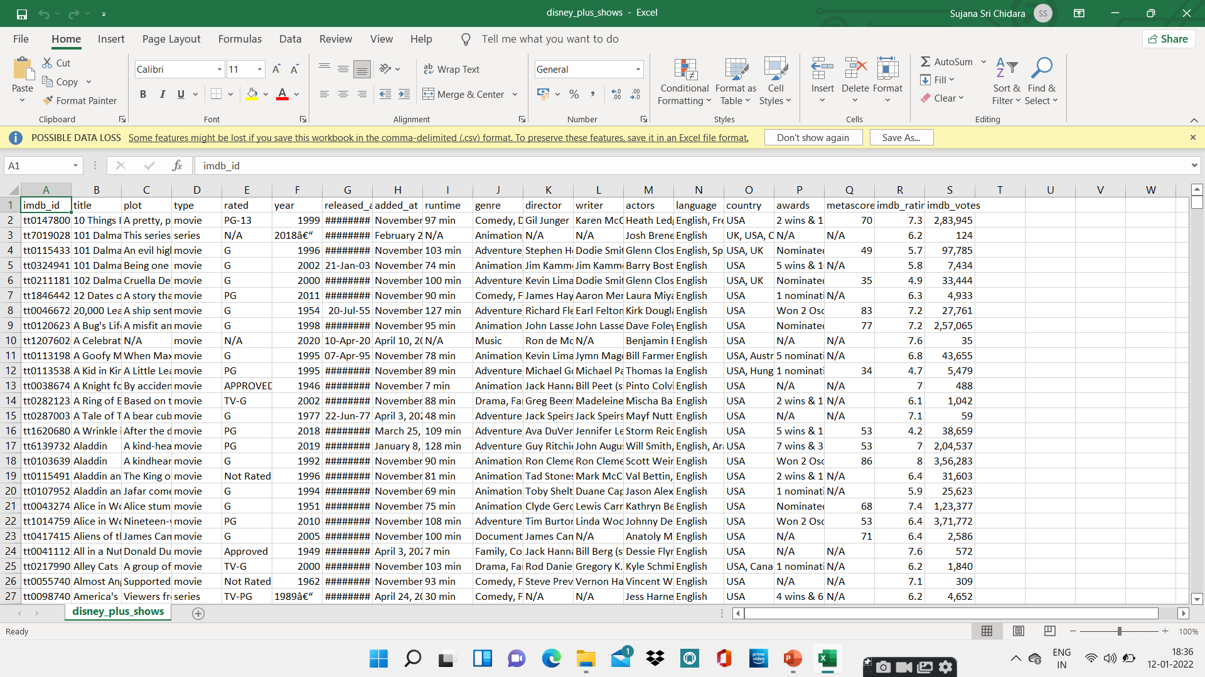
DATA SETS
OTT platform analysis tools dashboard creation contains 3 data sets:
Amazon prime video
Disney+ hotstar
Netflix
The above given are the data sets of different OTT platforms which include different attributes like movie name, genre, running time, budget, type(either series or movie), language, region, IDMB _ rating, etc.

Slide 7
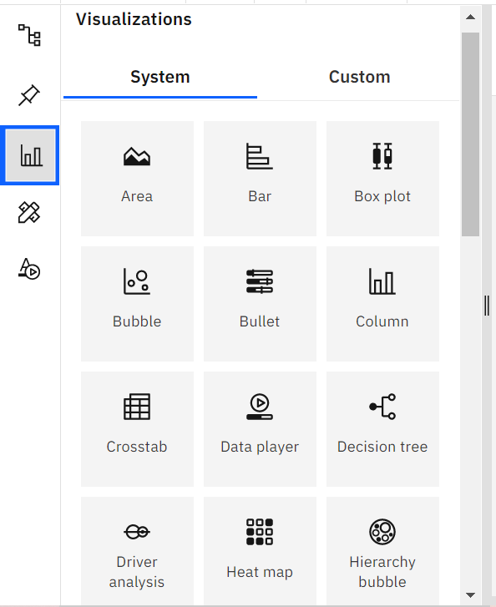
Data visualisation
Data visualization is where a given dataset is presented in a graphical format.
It helps the detection of patterns, trends and correlations that might go and detected in test based data.
Using the e commerce dataset we plan to create various graphs and charts to high light the insights and visualizations.
To visualize the dataset we need ibm cognos analytics dashboard.
This dashboard contains different visualization charts such as bar, area, bubble, column, pie, etc charts

Slide 8
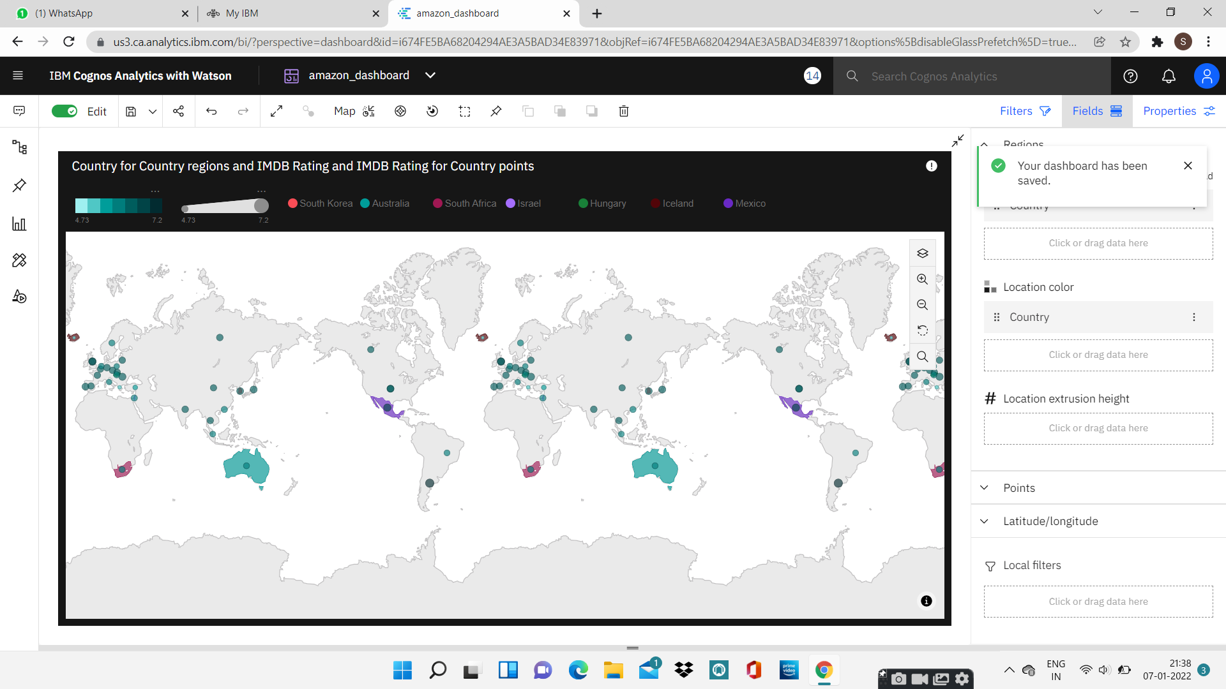
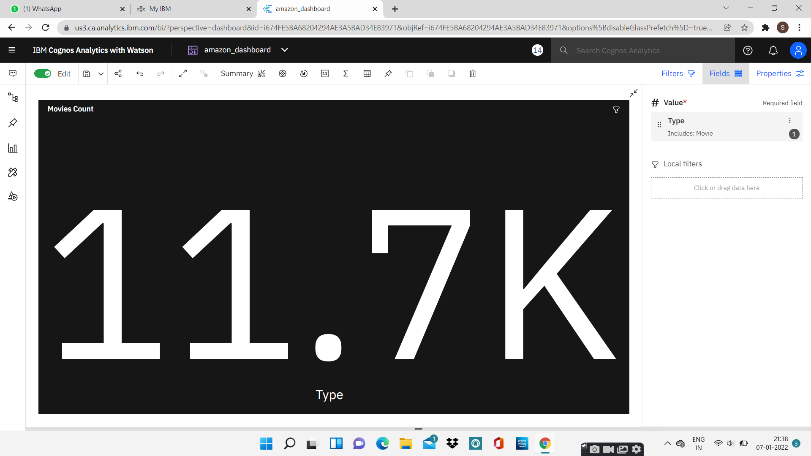
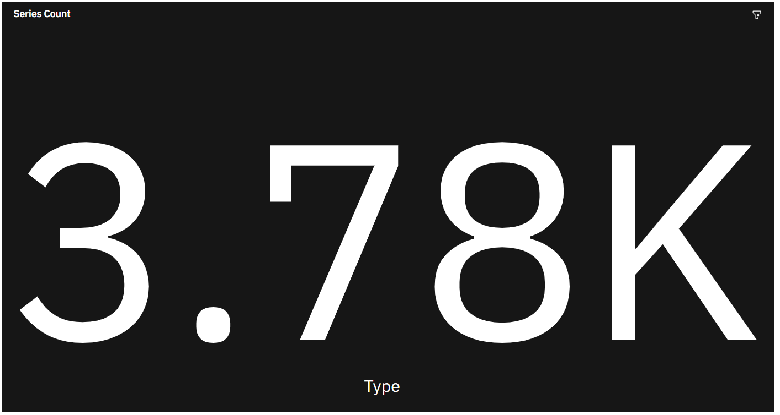
DATA VISUALISATION CHARTS

Slide 9
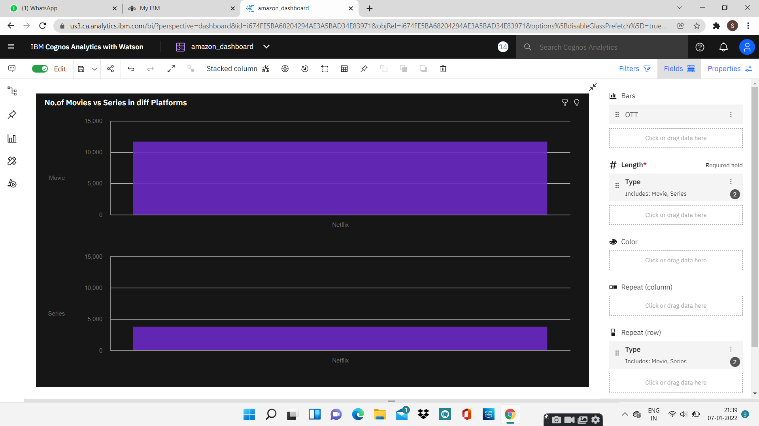
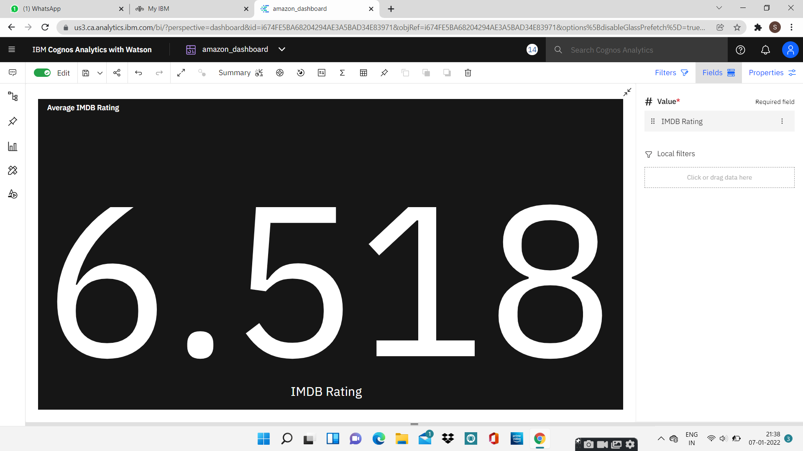
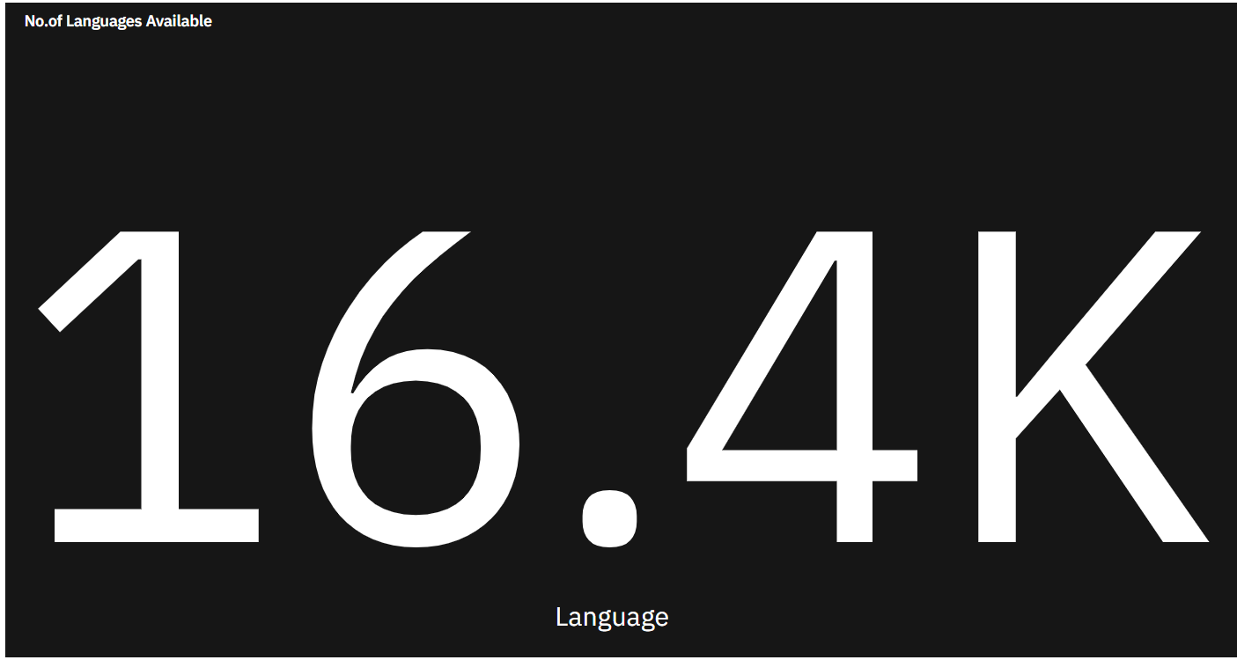
DATA VISUALISATION CHARTS

Slide 10
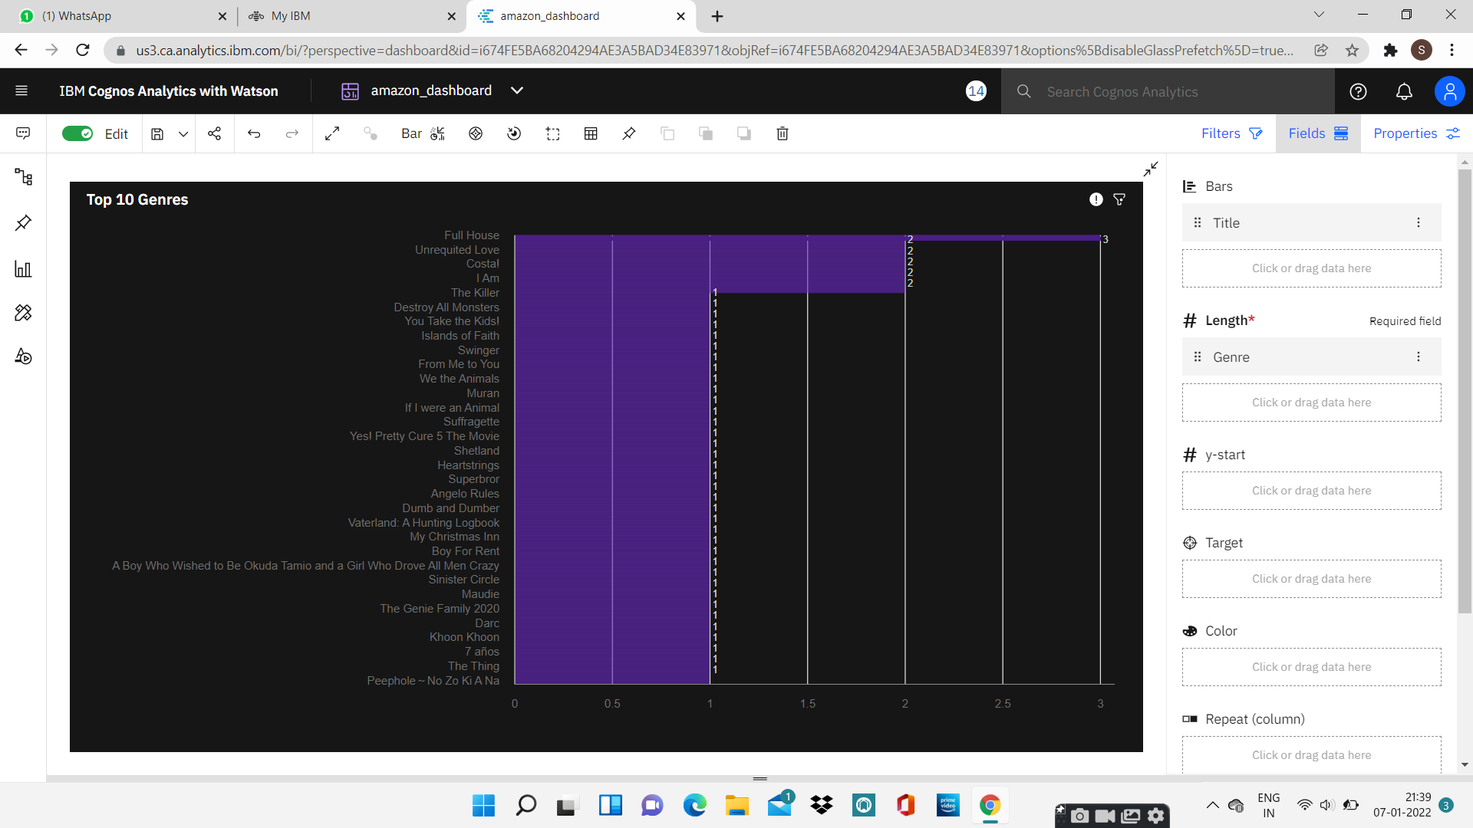
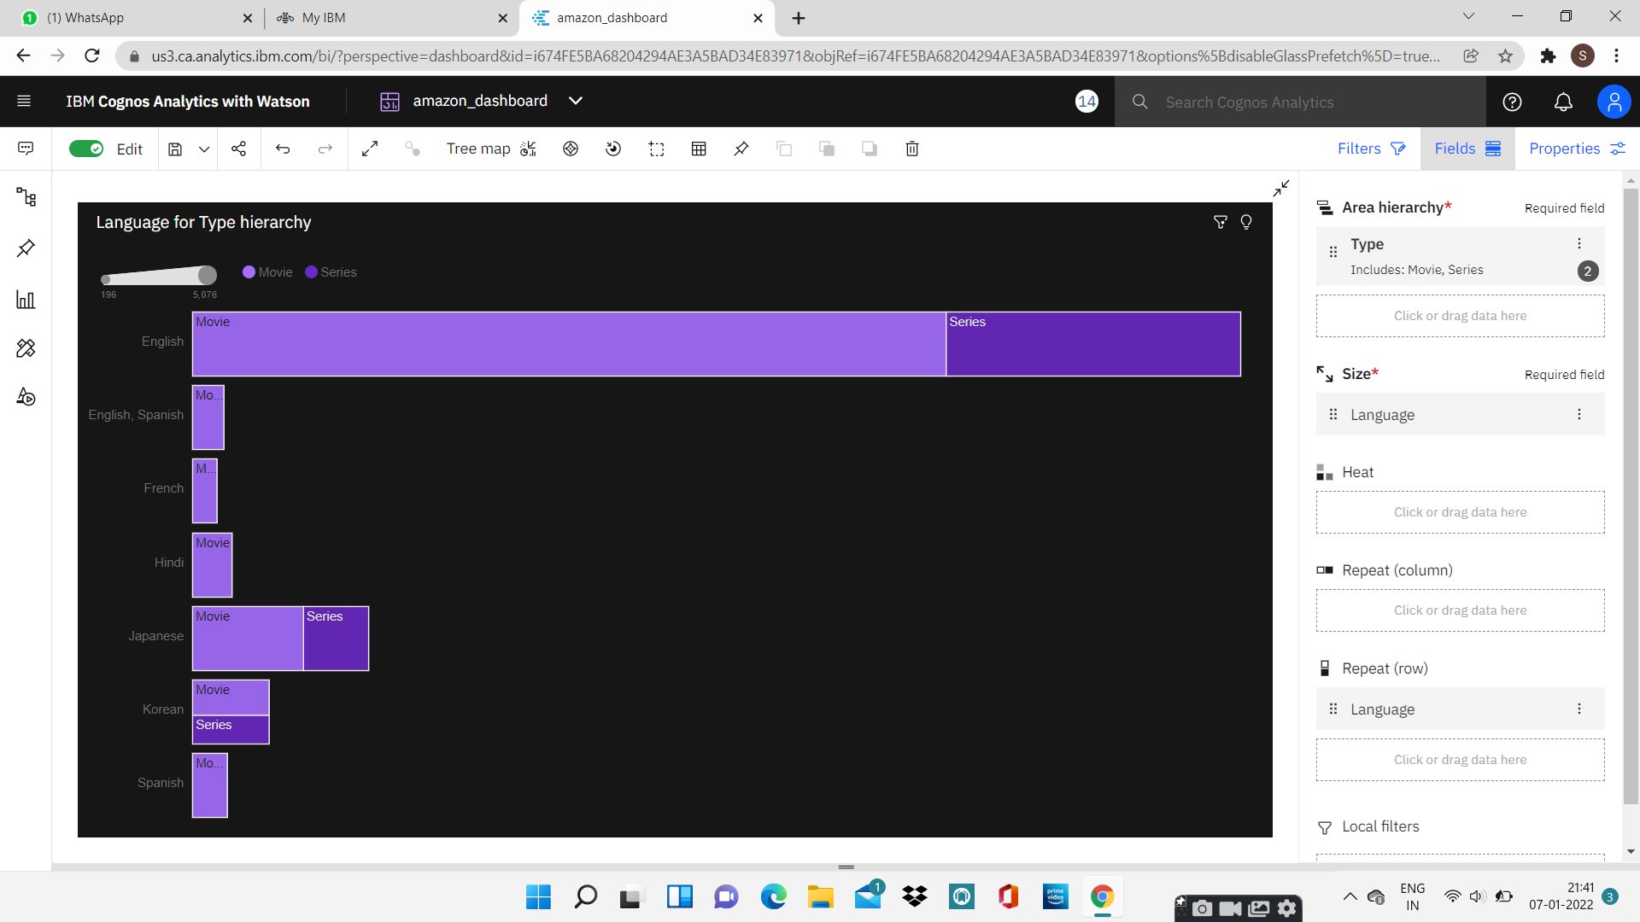
DATA VISUALISATION CHARTS

Slide 11
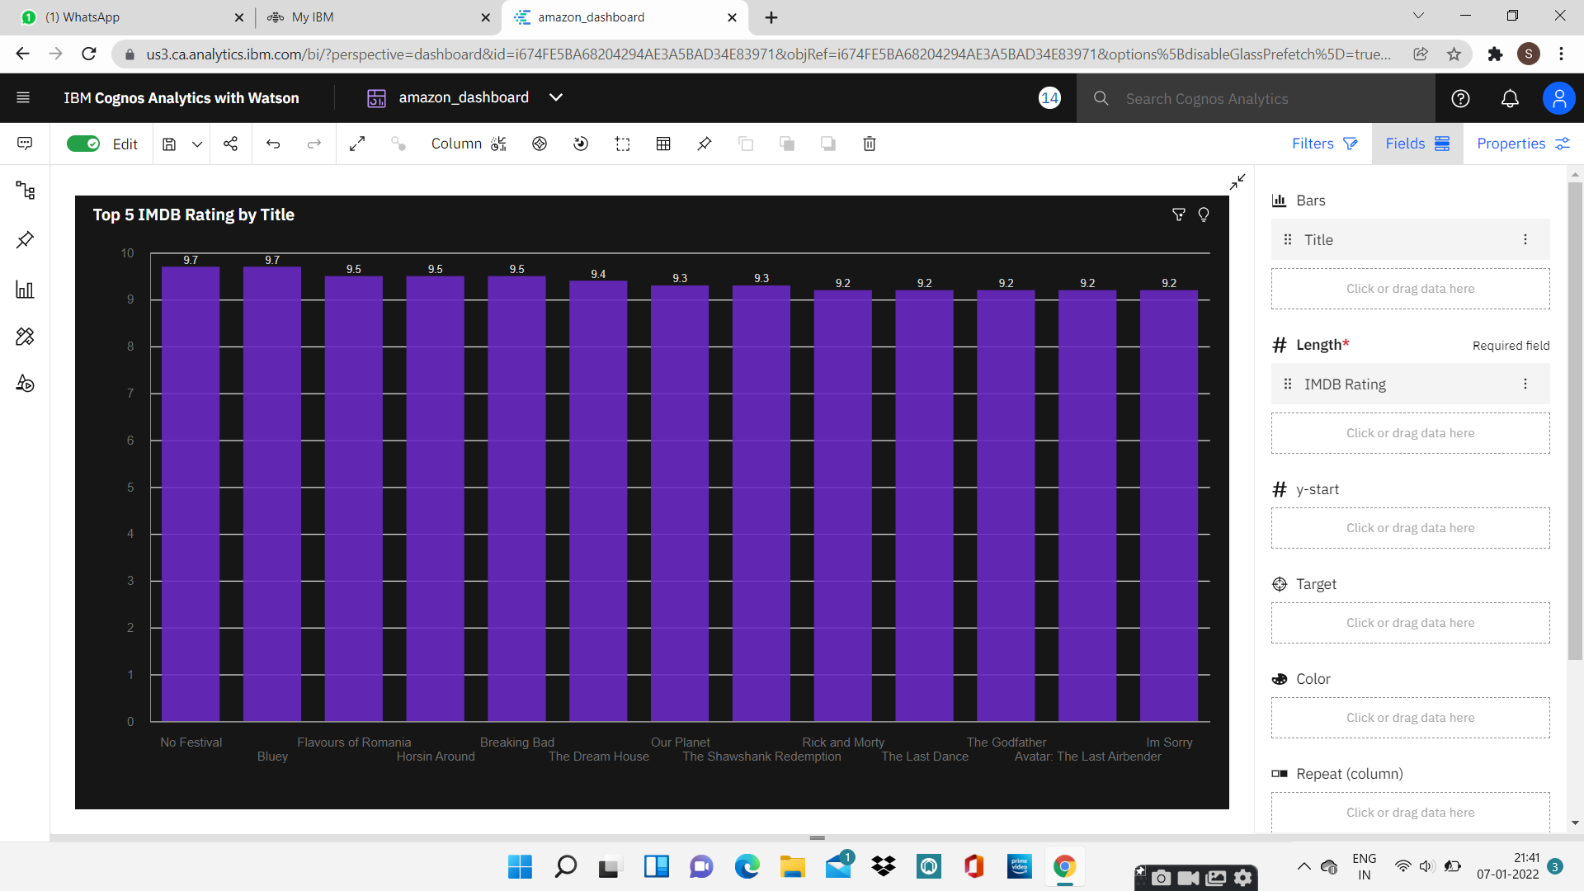
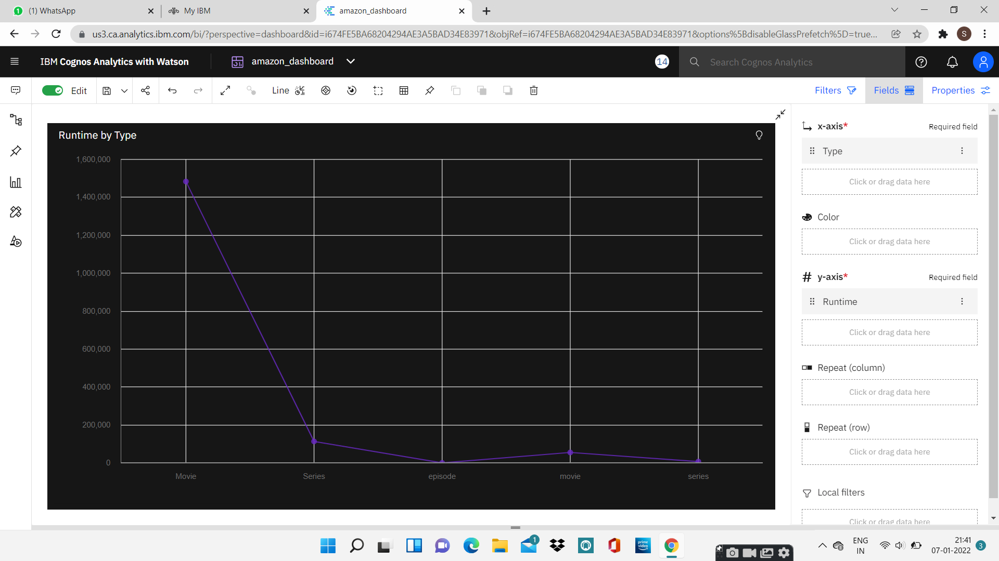
DATA VISUALISATION CHARTS

Slide 12
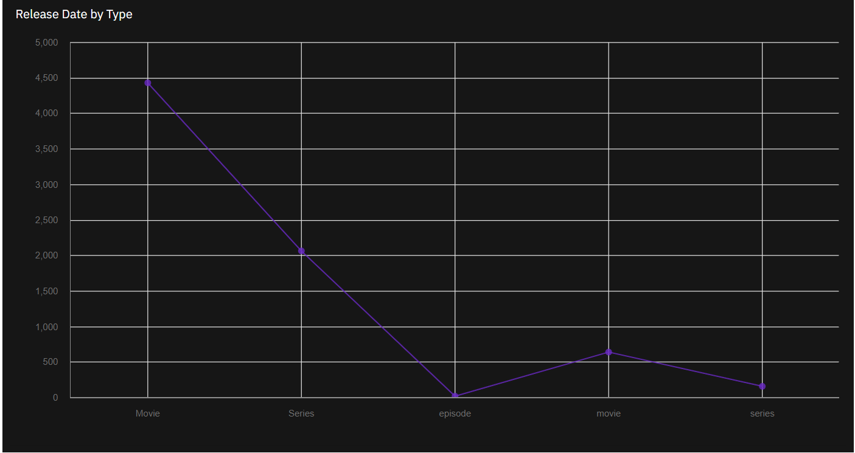
DATA VISUALISATION CHARTS

Slide 13
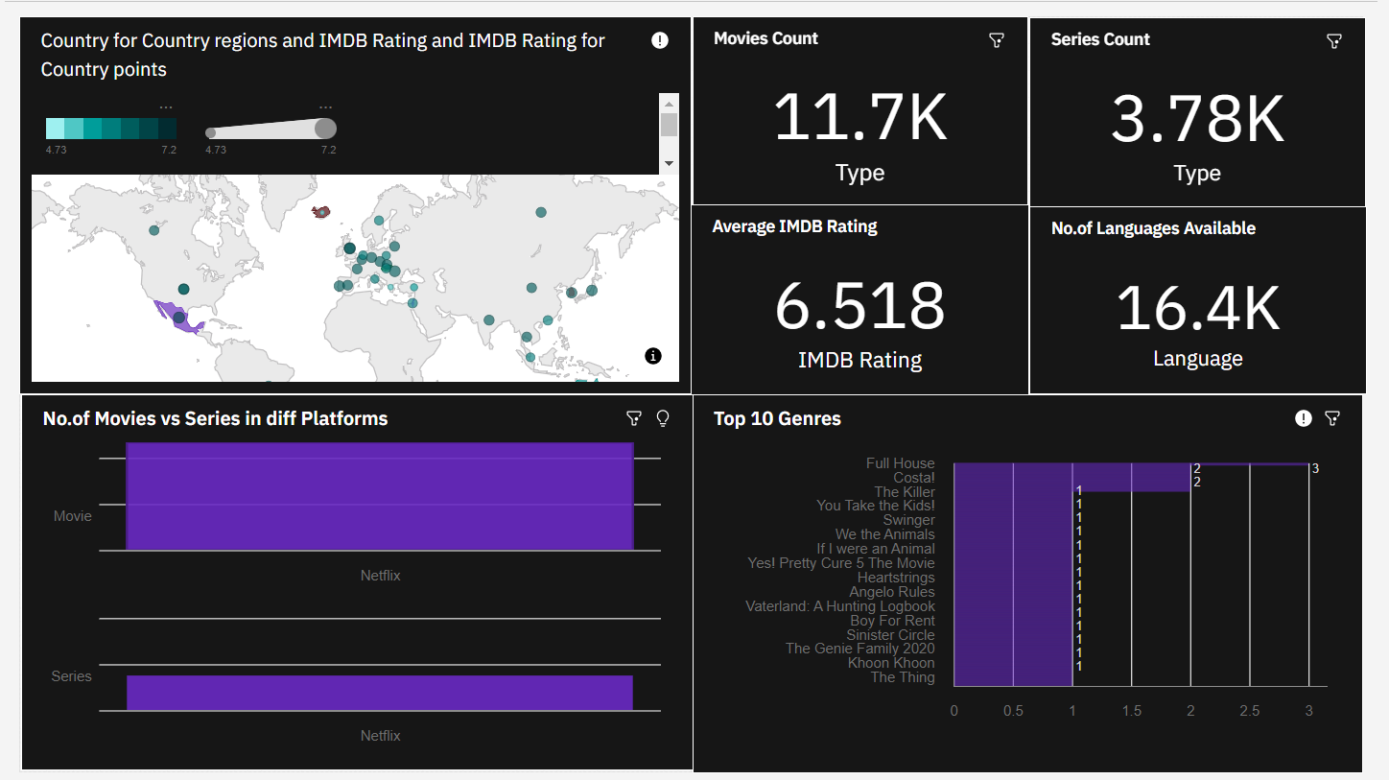
DASHBOARD CREATION

Slide 14
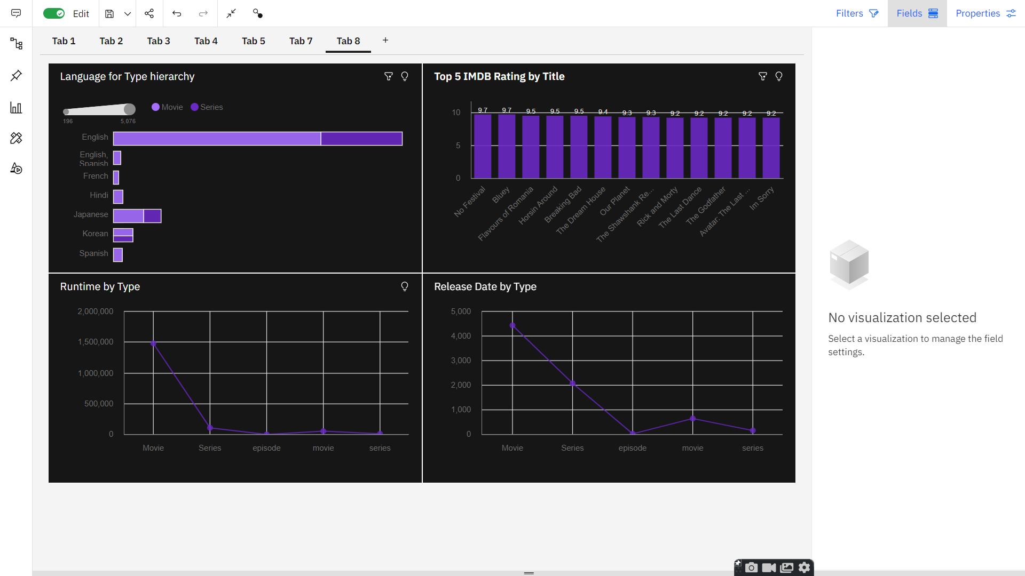
DASHBOARD CREATION

Slide 15
CONCLUSION
In this project we have presented that we will be analyzing some important visualizations, creating a dashboard and by going through these we will get most of the insights of E- commerce.
By the end of this project you will :
Know fundamental concepts and can work on IBM Cognos Analytics.
Gain a broad understanding of plotting different graphs.
Able to create meaningful dashboards

Slide 16


